Slide 1
Violence against women: Going beyond the US

Slide 2
Violence against women: A global problem
Global pandemic
“most pervasive yet least recognized human rights abuse in the world” (United Nations Population Fund, 2014).
Between 35 and 70 percent of women have experienced non-partner sexual abuse and physical violence at the hands of an intimate.
Over 46 million girls are child brides Women represent 55 percent of all people trafficked into forced labor.
40 to 50 percent of women in countries in the European Union have reported experiencing unwanted sexual advances and harassment at work, including unwanted physical contact.

Slide 3
Violence against women: A global problem
Types of violence against women that receive lesser attention in the US?
  Dowry deaths
  Street Harassment
  FGM
  Acid burnings
  Honor killings
  Self-immolation
  Conflict crimes – such as rape/genocidal rape
  Post conflict crimes
  Human Trafficking

Slide 4
The role of the state: Definitional issues
State crime is any:
  “economic, cultural, or physical harm, pain, exclusion, or exploitation . . . [caused by] tacit or explicit state actions or policies which violate law or generally defined human rights” (Kauzlarich, Matthews and Miller, 2001, p. 176)
  Includes omissions

Slide 5
How the state commits gender-based violence
Controls laws and law-making
Enforcer of laws
Primary definer of issues of concern
  What is considered violence/crime
Hegemonic discourse (Gramsci)
Permits the larger structural environment to persist
  Patriarchal

Slide 6
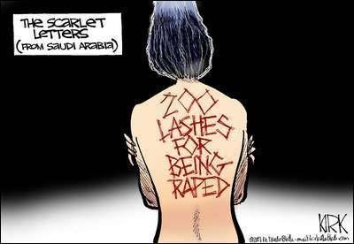
Violence against women: A global problem
Gender as a social structure
Role of the state as a direct perpetrator
  Examples?
More easily linked to state actors
State policy/law
  Girl of Qatif
State endorsed behaviors
  Rape as a weapon of war
    Bosnia/Herzegovina

Slide 7
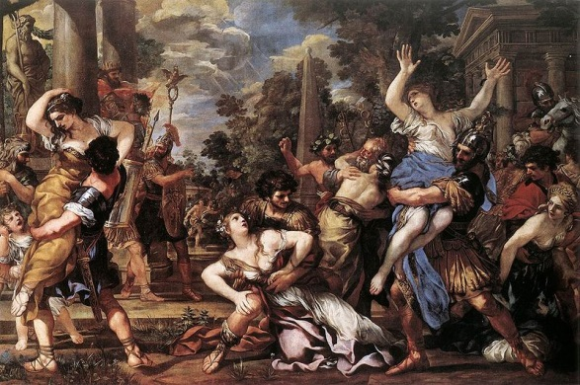
Inter-clan conflicts
“spoils of war”

Slide 8
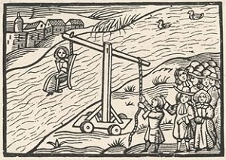
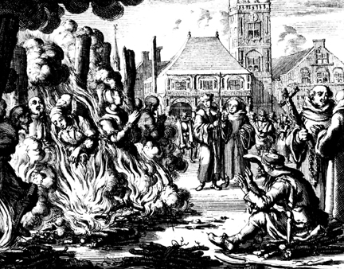
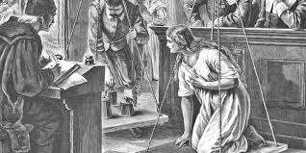
Witches

Slide 9
State as a facilitator/indirect actor
Role of the state as a facilitator
  Examples?
  Denial of education
  Forced/early marriage
  Rape culture – New Delhi gang rape
  Elevated risk of rape for women at University in the US
  Global HIV rates
  Theocratic states
State behaviors, or lack of, that facilitate and reify violence against women

Slide 10
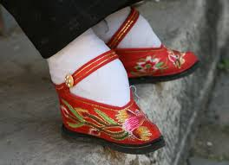
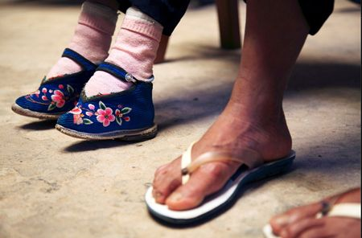
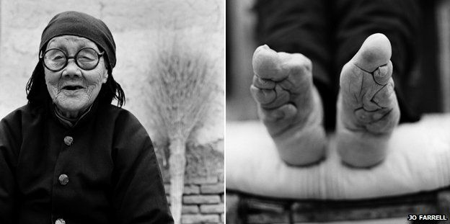
Historical examples of state as a facilitator
Foot binding in China

Slide 11
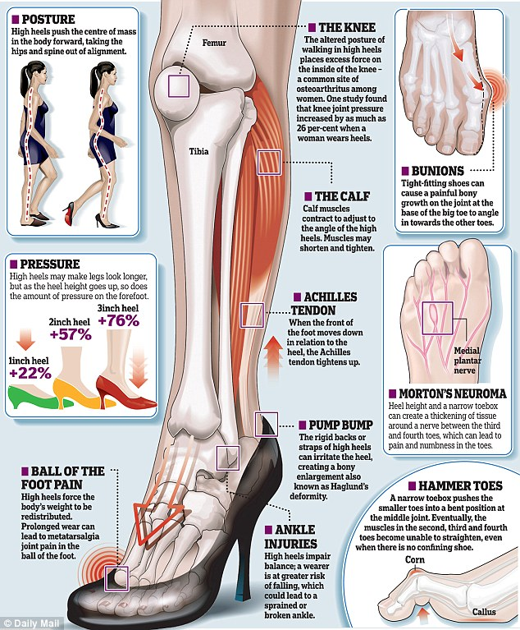
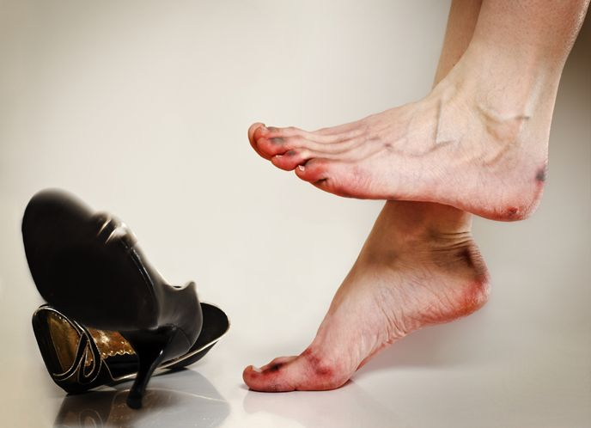
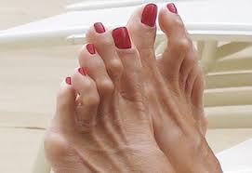
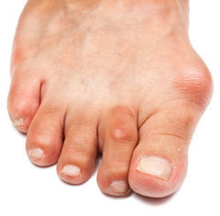
High heels?

Slide 12
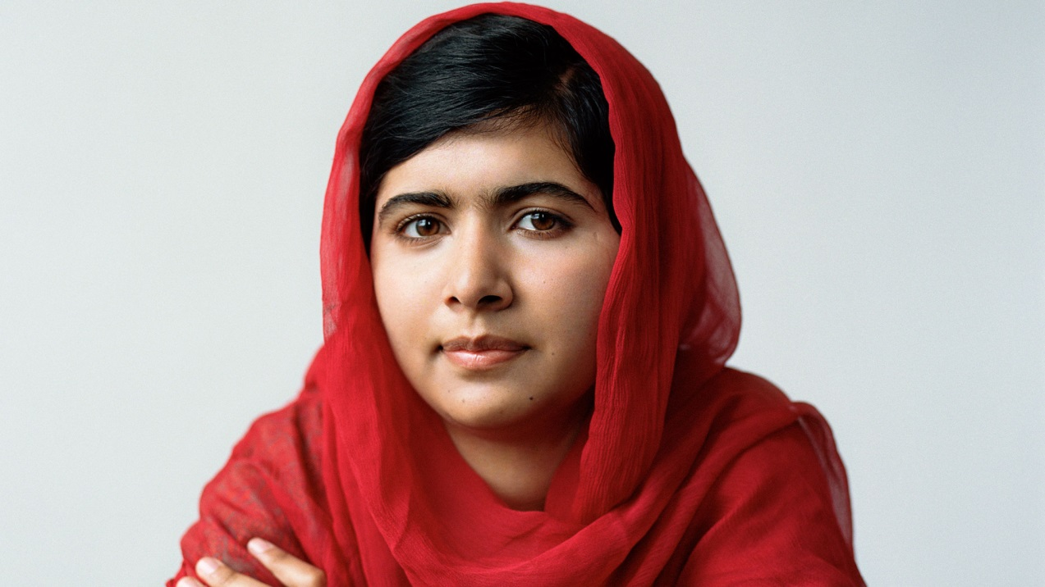
The role of the state as an indirect perpetrator
Who?

Slide 13
Indirect forms of state-perpetrated gender-based violence
State can:
  Be subtle
  Appear to be gender-neutral
  Appear to be protective towards women
Does this by regulating the system to prevent further oppression
But is it always effective??

Slide 14
Forced marriage
Forced marriage
“A marriage where one or both parties do not consent freely to the marriage; entry into the marriage is accompanied by physical, mental, and/or emotional duress and coercion from family members” (Gangoli, Razak, & McCarry, 2006)
Child?
UN Convention on the Rights of the Child, 1989

Slide 15
Types
Different from arranged marriage?
Countries with the highest rates of forced marriage
  Niger, Chad, Mali, Bangladesh, Guinea, and the Central African Republic
Role of customs and traditions?
Laws conflict with customs and traditions

Slide 16
Types
Patterns general to countries with higher prevalence of forced marriage
  More overt gender roles
  Domestic work is not valued as much as work outside the home
  Women’s work is diminished
  Fewer resources designated to women and girls
  A young woman’s wellbeing becomes tied to her ability to secure a husband
  Different marriageable ages for men and women
  Poverty

Slide 17
Types
Example, a young woman living in Pakistan explained,
“My mother decided my marriage because we were homeless. My father died, my mother’s in-laws kicked her out of their home and her parents had died. My marriage helped my mother reduce her responsibilities” (Lane, 2011)
Commodification?
Legal system
Banishment
Violence

Slide 18
Types
The role of honor
  Value that an individual has or others perceive an individual as having.
  It can be both achieved and lost and when it is lost the result is shame.
  Women embody the “honor” of the men to whom they belong
  Women’s bodies are the repositories of family honor
Ouis (2009) honor ideology is the product of “‘honour cultures’ [where] children are threatened by or exposed to violence in relation to codes of sexual morality and general behavior” (p. 445).

Slide 19
Honor killings
Relatives kill, and commit acts of violence against wives, Mothers, daughters and sisters to restore honor to the family
Family honor may have been lost as a result of a real or perceived actions that have compromised it
Restores the honor

Slide 20
Prevalence
The United Nations Population Fund estimates that 5000 die as a result of honor killings worldwide
In Alexandria, Egypt a study of femicides indicated that 47 percent were killed after the woman had been raped
In Jordan and Lebanon 75 percent of the perpetrators of honor killings were the women’s brothers

Slide 21
Where they occur
The UN reports these crimes have been found to occur in the following countries:
Bangladesh
Iraq
Sweden
Brazil
Israel
Turkey
Ecuador
Italy
Uganda
Egypt
Jordan
United Kingdom
India
Morocco
Iran
Pakistan
US

Slide 22
Honor
Not specific to one religion
Behaviors that can result in the loss of honor?
  Infidelity
  Walking outside without a chaperone
  Inappropriate behavior/clothing
  Disrespecting one’s father, husband, brother
  Entering a relationship with an unapproved suitor
  Being disobedient
  Rejecting a suitor
  Victimization

Slide 23
Honor Killings
Ankara, Turkey -Ignoring the pleas of his 14-year old daughter to spare her life, Mehmet Halitogullari pulled on a wire wrapped around her neck and strangled her - supposedly to restore the family's honor after she was kidnapped and raped... "I decided to kill her because our honor was dirtied," the newspaper Sabah quoted the father as saying. "I didn't listen to her pleas, I wrapped the wire around her neck and pulled at it until she died" (The Associated Press).

Slide 24
Honor
Can be real or perceived
Suspicion can be enough
Amnesty International reported a man killed his wife as she had a dream about committing adultery

Slide 25
Justifications
Interplay between tribal traditions of justice and statutory law
Also exacerbated in some countries where there is Shari’a law, Islamic law, or zina (sex outside of marriage is a statutory offense).
Women are often secluded and do not know their rights under international law

Slide 26
Justifications
Some countries have passed laws that allow lesser penalties for men who kill "in the name of family honor"
Law enforcement are often bribed by family members to ignore reports of the murder
Police may help the killers family to cover up the crime by delaying the investigation

Slide 27
Justifications
Law enforcement fail to enforce punishment for the crime
For example, if convicted of zina in Pakistan then a woman can be imprisoned
In tribal justice systems in Pakistan a woman can be killed if she is suspected of sex outside her marriage

Slide 28
Justifications
Under Jordanian and Pakistani law, women are expected to meet impossible requirements for "corroborating evidence" in order to prove allegations of rape.
Even if a woman meets these requirements, evidence of previous sexual activity may be admitted in proceedings and lead to her being charged with zina.

Slide 29
Communal aspects of honor killing
Large sections of society share traditional concepts of family honor
They approve of honor killings to maintain that honor
Even mothers who have had daughters killed in the name of honor condone the practice
This strengthens the view of women as property

Slide 30
Testimony from perpetrators
Convicted killers often speak with defiant pride and without regret about their actions. "We do not consider this murder," said Wafik Abu Abseh, a 22-year-old Jordanian woodcutter who committed a so-called honor killing, as his mother, brother and sisters nodded in agreement.

Slide 31
Testimony from perpetrators
"It was like cutting off a finger." Abdel Rahim, a convicted killer who was released after two months, also said he had no regrets. "Honor is more precious than my own flesh and blood" (New York Times).

Slide 32
Honor Killings
The murder of women in the name of "honor" is a gender-specific form of discrimination and violence.
In societies where so-called honor killings are allowed to occur, governments are failing in their responsibility to protect and ensure women their human rights.

Slide 33
International Law
Article 1 of the UN Declaration on the Elimination of Violence Against Women proclaims "the term 'violence against women' means any act of gender-based violence that results in, or is likely to result in, physical, sexual or psychological harm or suffering to women, including threats of such acts, coercion or arbitrary deprivation of liberty, whether occurring in public or in private life"

Slide 34
International Law
The Convention on the Elimination of Discrimination of All Forms Against Women (CEDAW) concludes that "...State Parties [should] take all appropriate measures [...] to modify the social and cultural patterns of conduct of men and women, with a view to achieving the elimination of prejudices [...] and all other practices which are based on the idea of inferiority or the superiority of either of the sexes or on stereotyped roles for men and women"

Slide 35
Street harassment
Street harassment
when one or more unfamiliar men accost one or more women in a public place, on one or more occasion, and intrude or attempt to intrude upon the woman’s attention in a manner that is unwelcome to the woman, with language or action that is explicitly or implicitly sexual.
https://www.youtube.com/watch?v=QYAL21jxREQ
Men often perceive themselves as being complimentary
Thoughts?
What types of feelings does it illicit in women?

Slide 36
Street harassment behaviors
It ranges from leers, whistles, honks, kissing noises, gender-policing, and non-sexually explicit evaluative comments, to more insulting and threatening behavior like vulgar gestures, sexually charged comments, flashing, and stalking, to illegal actions like public masturbation, sexual touching, assault, and murder
Common myth: women invite street harassment through clothing choices

Slide 37
Street harassment
Related to ownership of public space
Women have no right to privacy
Reinforces constructions of masculinity and femininity
Objectifies and dehumanizes women/girls
Message
  “women are interchangeable”

Slide 38
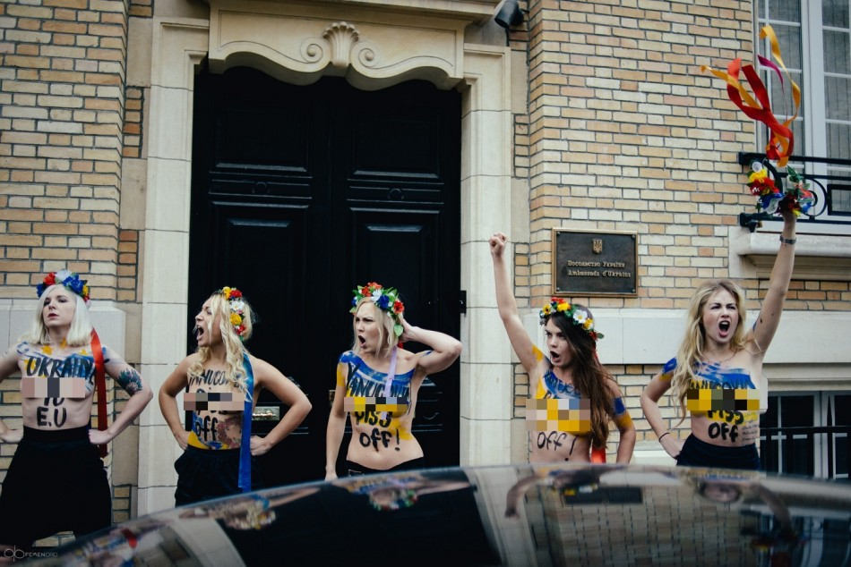
FEMEN

Slide 39
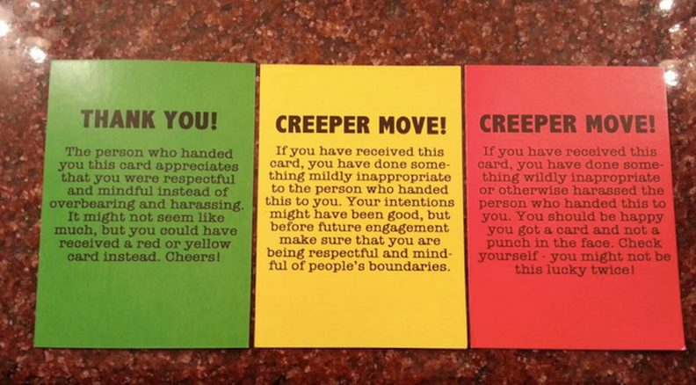

Slide 40
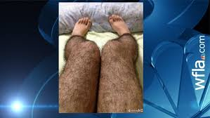
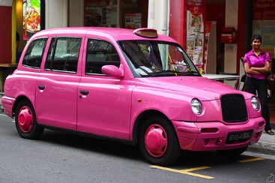
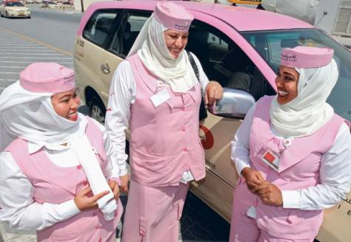


Slide 41
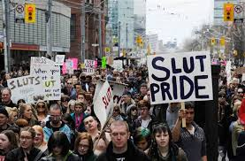

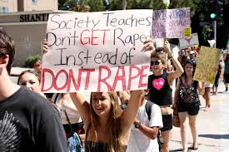
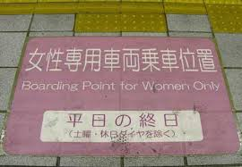
http://www.womenonguard.com/
http://www.ihollaback.org/share/

Slide 42


Hollaback

